Slide 1


UNIT 7: On top of the world
The great pet
dilemma

Slide 2
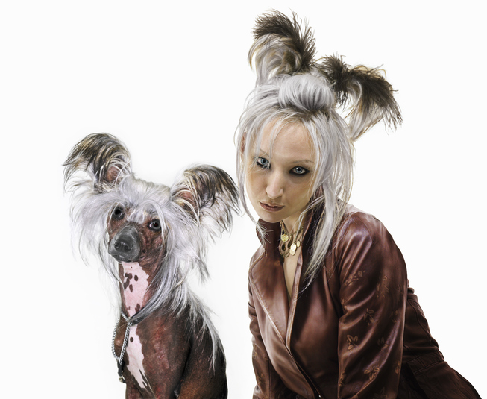
Do you think you are a good pet owner?
Who helps you?

Slide 3
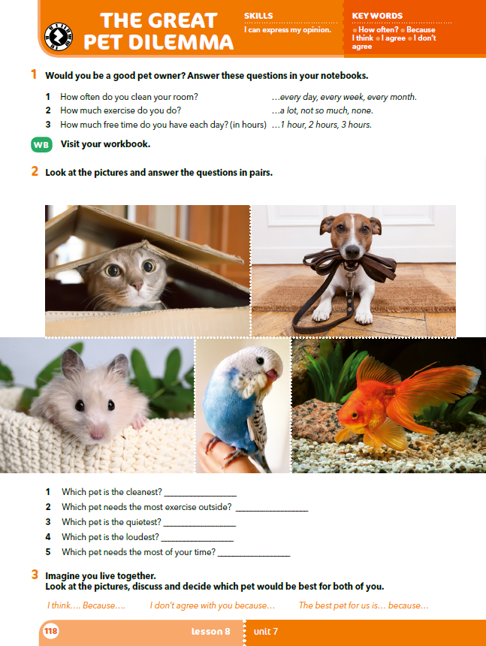
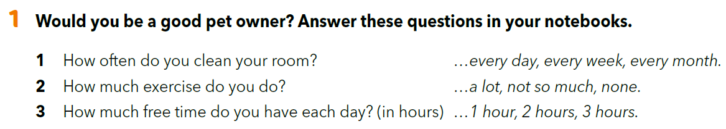
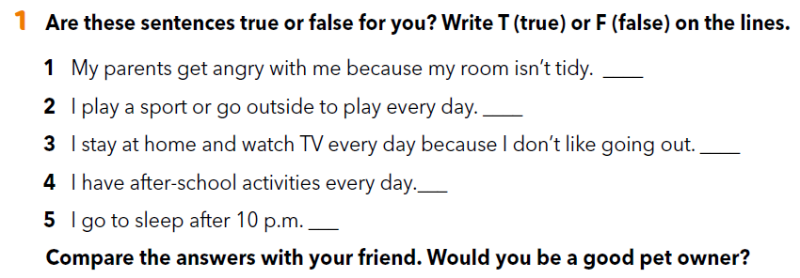
Workbook p. 81

Slide 4
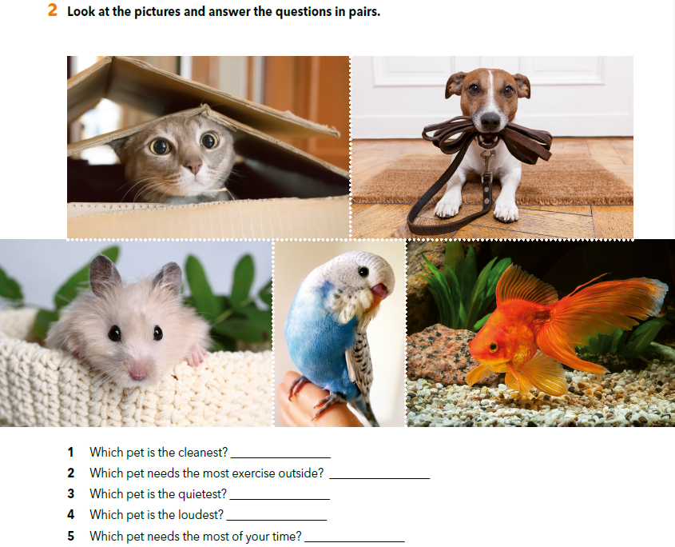
Work in pairs.
Imagine that you and your friend live together.
Would you have a pet or not?
Which pet would be the best for you and why?

Slide 5
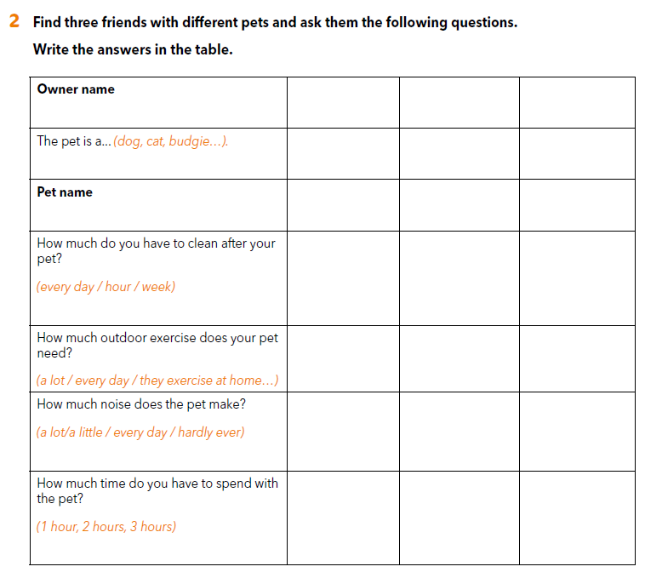
Workbook p. 81

Slide 6
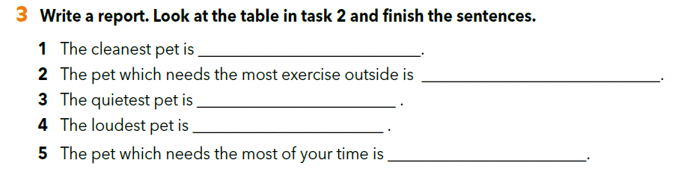

Slide 7
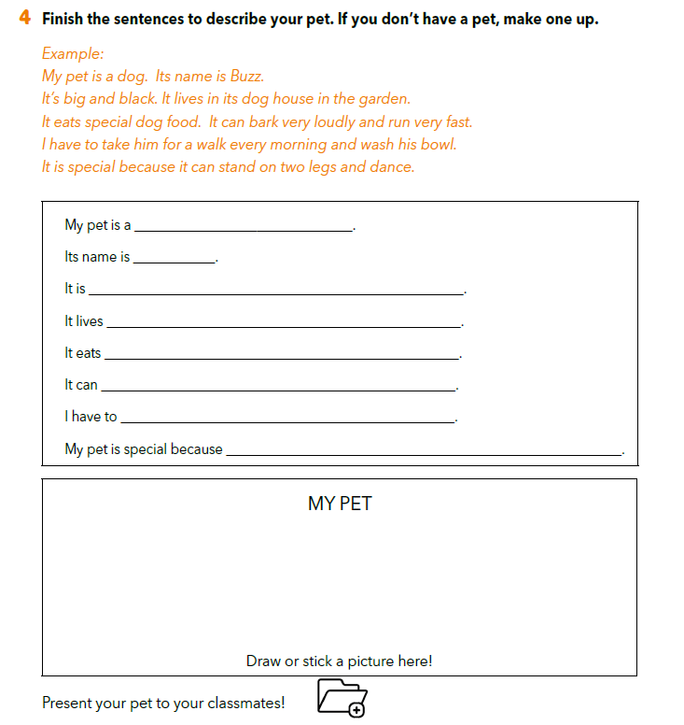

Slide 8

LET’S REVISE!
https://wordwall.net/resource/261680/great-pet-dilemma-discussion-time
SELF CHECK
https://www.e-sfera.hr/dodatni-digitalni-sadrzaji/d7ad89b6-fe3e-49c5-a63a-d252aa8fe9c3/

Slide 9
LEARN MORE
https://www.e-sfera.hr/dodatni-digitalni-sadrzaji/d7ad89b6-fe3e-49c5-a63a-d252aa8fe9c3/
How to choose a pet

